Slide 1
Lesson 5.1
Express.js/http Web Server

Slide 2
Learning Outcomes
Explain express.js and use its methods
Create a local web server
Install packages
Run web server
Test the web server from terminal, postman and browser
Use nodemon.js package

Slide 3
Full Stack Web Development
The combination of front-end and back-end web development is called full stack web development.
A back-end web application is a program that serves in support of a front-end web application’s functionality.
Back-end web applications run on a server.
It includes a database and/or file system.
It contains the business logic to receive requests from the front-end application and send the appropriate response data back.
A full-stack web developer is a person who can develop both client and server software:
They can program a client (e.g. HTML, CSS, JavaScript, Angular, React).
They can program a server (e.g. PHP, Node.js, Python, Ruby).
They can program a database (e.g. SQL, MongoDB).

Slide 4
Express.js
What is Express?
Express is a minimal and flexible Node.js web application framework that provides a robust set of features for web and mobile applications. It is an open-source framework developed and maintained by the Node.js foundation.
It makes it easier to organize your application’s functionality with middleware and routing.
Middleware is software that lies between an operating system and the applications running on it that enables communication and data management for distributed applications.
Routing is the mechanism by which requests (as specified by a URL and HTTP method) are routed to the code that handles them.
Express is used to facilitate the simple and easy interaction between front-end and back-end logic using an API.

Slide 5
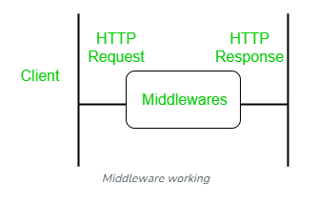
Middleware
Middleware gets executed after the server receives the request and before the controller actions send the response.
Middleware has access to the request object and the response object. It can process the request before the server sends a response.
An Express-based application is a series of middleware function calls.

Slide 6
Express.js
Steps to setup a basic express web application:
Create a new directory on your computer using the name of your project.
Create an app.js file, which will be our main program.
Open a terminal and navigate to that directory.
Type npm init and then press Enter. Answer all questions. This creates your package.json.
Type npm install express --save and press Enter. This installs the express module and adds it as a dependency in package.json.

Slide 7
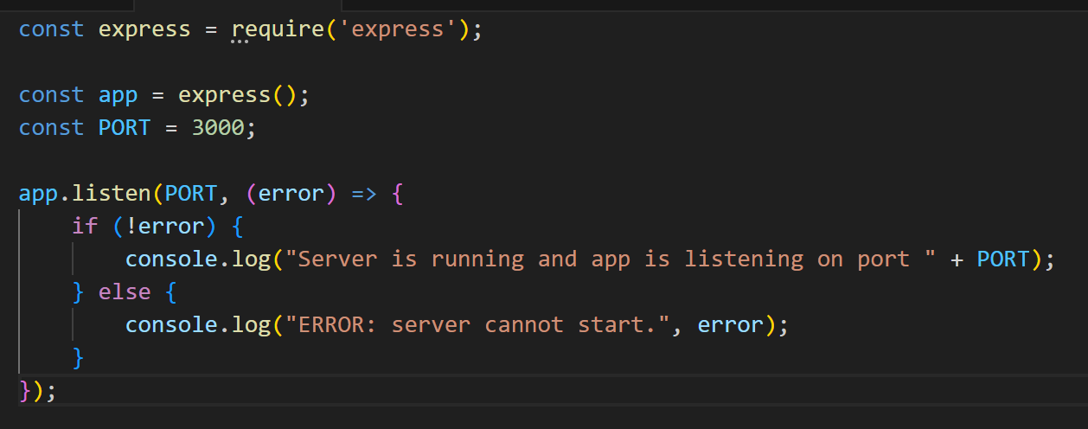
Express.js
Enter the following code into app.js:
Run the application by entering node app.js in your terminal. The success message should be displayed. Your express server is running!

Slide 8
Express.js Pro Tip!
Problem: our server is currently running and anytime we make a change to our server’s code, we must stop and restart it for the changes to take effect.
Solution: to make our development process easier, we can install an npm package called nodemon. Nodemon restarts our server as soon as we make a change in any of our files.
To install nodemon, use the following command: npm install nodemon --save
Nodemon should now be added as a dependency in package.json.
To start a server using nodemon, use the command nodemon app.js (instead of node app.js).

Slide 9
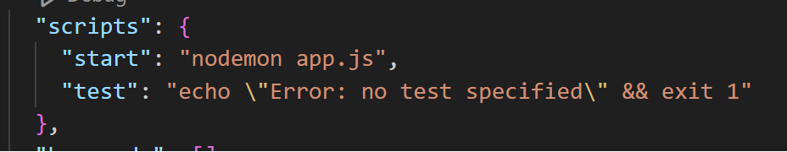
Express.js Pro Tip!
Open package.json and add the following line inside the “scripts” section:
This script allows us to open the command line and type npm start to achieve the same result of typing nodemon app.js.

Slide 10
Express Routes
Now we will set the routes for our application.
Routes are the endpoints of the server.
They are configured in the back-end code.
Whenever a request is sent to those endpoints, our back-end code will respond accordingly.
You can consider a route as a function that gets called when someone requests the special path associated with that function.
We can create routes for the HTTP methods GET, POST, PUT, and DELETE.
Syntax of a route:
app.method(path, function);
“app” is an express application.
“method” is one of the HTTP methods (GET, POST, PUT, DELETE).
“path” is the route’s URL
“function” is the callback function that will be executed when that route is requested with the method.

Slide 11
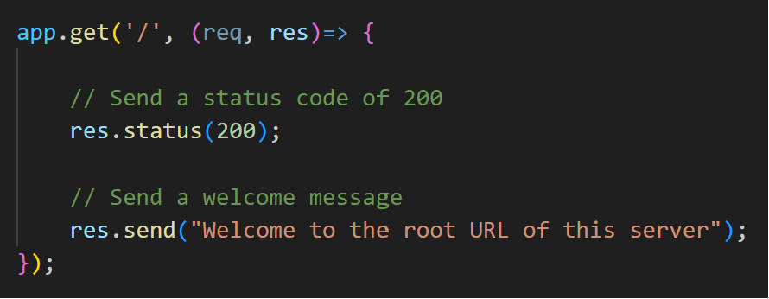
Express Routes
Example: setup a basic GET request route on the root URL (“/” path) on the server.
Express provides the request (req) and response (res) objects as a parameter to the callback functions.
Now go to localhost:3000 and see the message from your server.

Slide 12
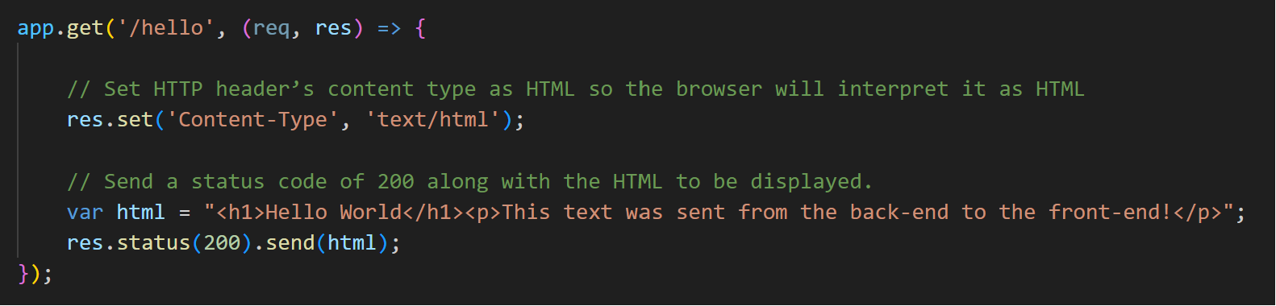
Express Routes
Example: a GET request route at the endpoint "/hello" that responds with some HTML

Slide 13
Postman
Postman is an API platform for building and using APIs.
We will be using it to test our back-end application.
Do the following:
Download the desktop application: https://www.postman.com/downloads/.
Create an account.
Test it using a back-end application that you have built on your computer.

Slide 14
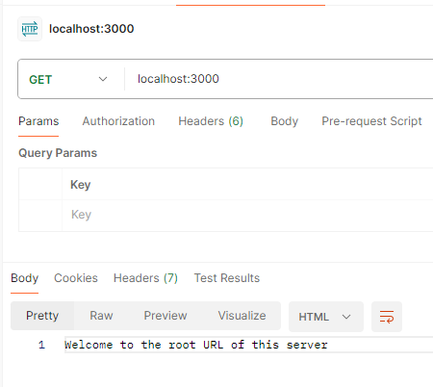
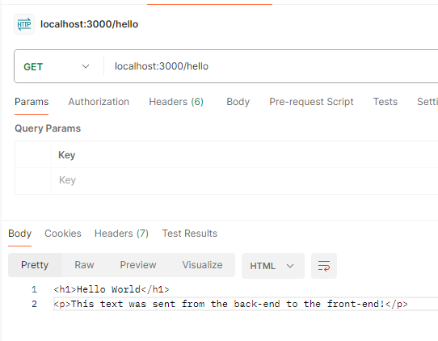
Postman

Slide 15
Express Routes
Now we want to setup the ability for the client to send data to the server (e.g. creating a blog post, signing into an application).
To do this, we need a tool that can send data to the server as a request. A browser’s search bar can only send GET requests.
Examples:
An HTML form can send data.
Postman can also send POST, PUT, and DELETE requests.

Slide 16

Express Middleware
We also need some middleware to help us process those requests.
In our express application middleware functions are functions that have access to the request object (req), the response object (res).
These functions are used to modify request and response objects for tasks like parsing request bodies, adding response headers, etc.
The syntax to run middleware on a Node.js web server application that uses express is:
app.use();
Let’s add the express.json() middleware to our application which will allow us to parse an incoming request object as a JSON object.

Slide 17
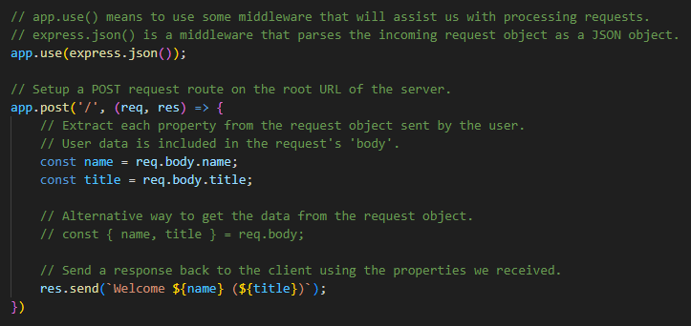
Express Routes
Example: a POST request route on the root URL of the server.

Slide 18
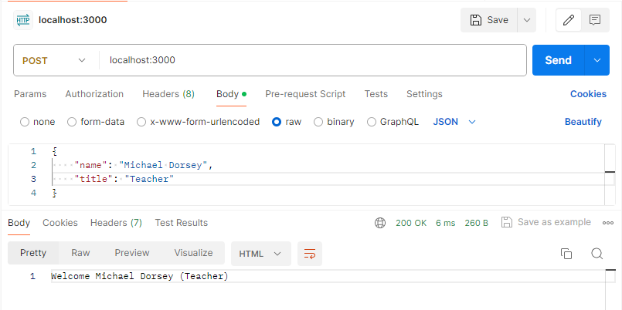
Express Routes
Now that your POST route is setup, use Postman to send a POST request:
Set the method to be POST
Set the URL to be localhost:3000
Open the “Headers” tab and add the following header:
Key: “Content-Type”
Value: “application/json”
Open the “Body” tab, then select the “raw” radio button to send raw JSON data.
Write JSON text that includes “name” and “title” fields.
Click SEND.
You should receive the proper response.

Slide 19
Congratulations!
You have just created a RESTful API!

Slide 20
Routing

Slide 21
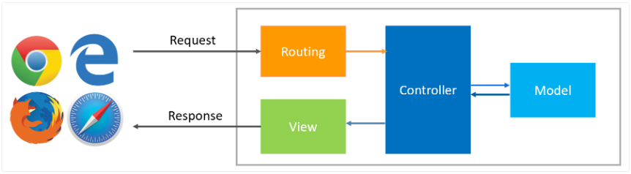
Express Routing
Routing is the mechanism by which requests (as specified by a URL and HTTP method) are routed to the code that handles them.
Routes are the endpoints of the server.
They are configured in the back-end code.
Whenever a request is sent to those endpoints, our back-end code will respond accordingly.
We can create routes for the HTTP methods GET, POST, PUT, and DELETE.

Slide 22
Express Routing
Syntax of a route:
app.method(path, function);
“app” is an express application.
“method” is one of the HTTP methods.
“path” is the route’s URL
“function” is the callback function that will be executed when that route is requested with the method.

Slide 23
Express Routing
Web frameworks provide resources (HTML pages, scripts, stylesheets, images, etc.) at different routes.
/about.html
/images/dog.jpg
/users/1001
/files/10-10-2020/package.zip
Defining and organizing routes can be tedious to maintain in a back-end application. Therefore, to separate routes from our main application we can use Express’s built-in Router feature.
Routers are helpful in separating concerns and keeping relevant portions of our code together. They help in building maintainable code.

Slide 24
Express Routing
“express.Router” is a class that can be used to create modular, mountable route handlers.
A Router instance is a complete middleware and routing system.
We will use the Express Router to create a router as a module, define some routes, then mount the router module on a path in the main application.

Slide 25
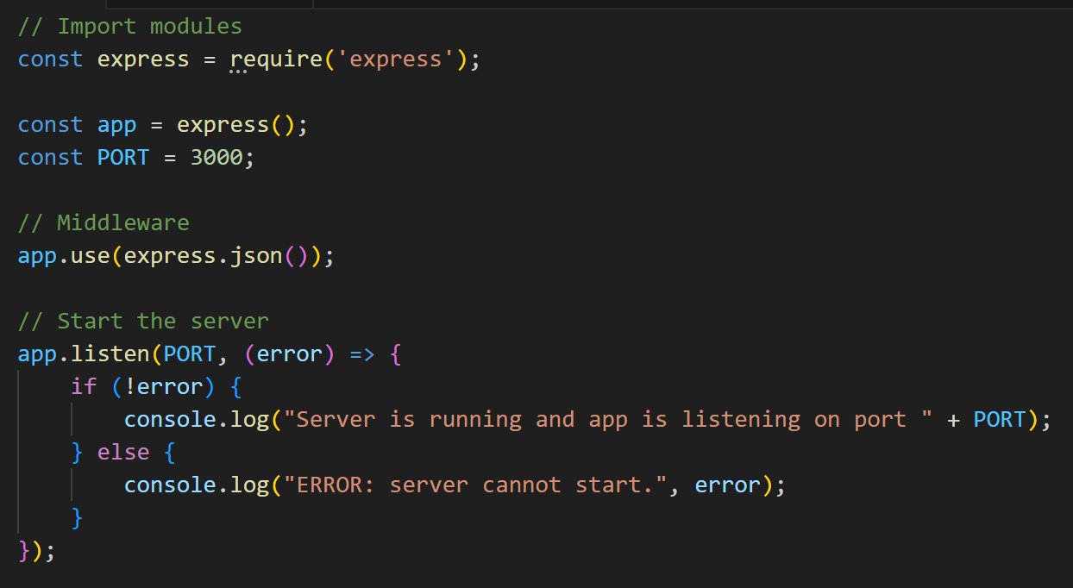
Application Setup
Setup a normal Node.js application:
Create a project directory.
Create an app.js file.
Run npm init to create the package.json file.
Run npm install express --save to install the express module.
Run npm install nodemon --save to install the nodemon module.
Create the start script in package.json: "start": "nodemon app.js",
Insert into app.js the normal code to create an express application.
Run npm start to start your application.

Slide 26
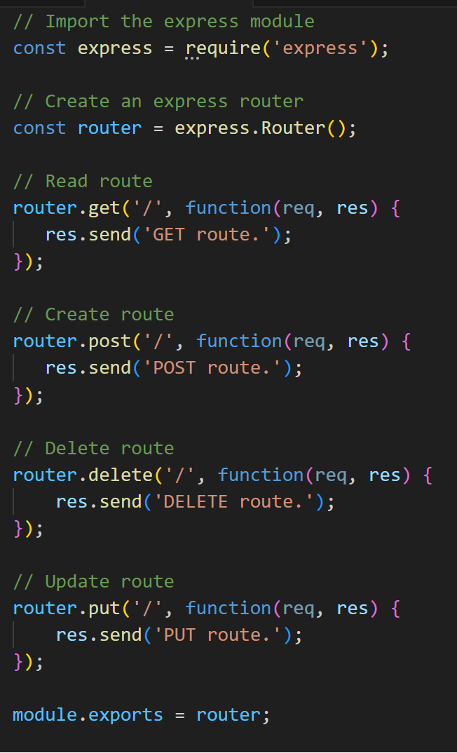
Create a Router
Create a new file called “routes.js” in our application’s directory.
Enter the following code in that file:
Import the express module and create the express router.
Then use the router to set the four basic CRUD routes.
Notice that this is just like we did with “app.get” and “app.post”, only now we are using our Express Router instead.
Finally, export our router so that our main application can import it.

Slide 27
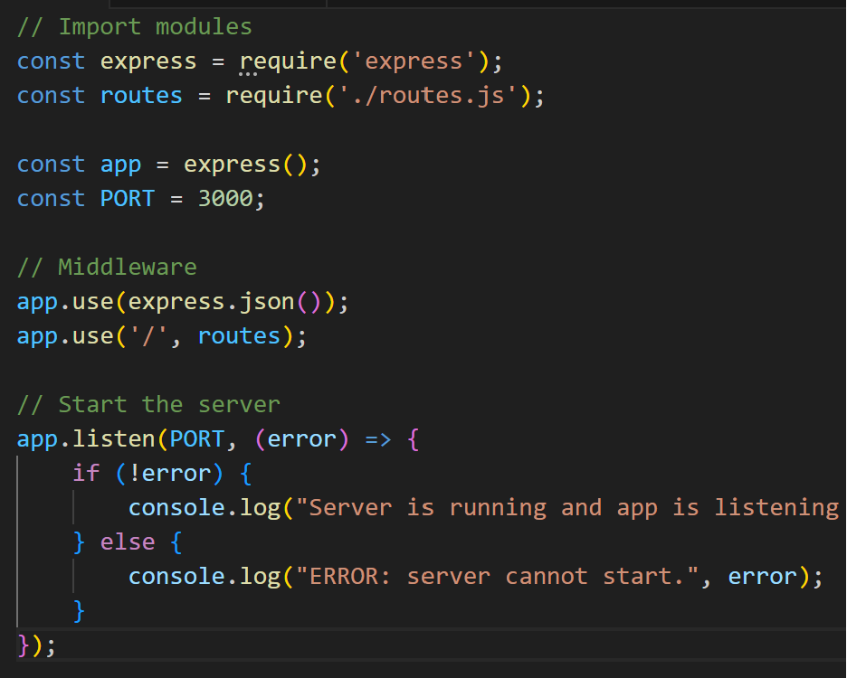
Create a Router
Open the main application file (app.js) and import (“require”) the routes.js file into it.
Update the app’s middleware (“app.use”) so that the route ‘/’ attaches to our router in routes.js.
Now whatever requests our app gets at '/' will be handled by our router.
Use Postman to verify that all four of our routes work.

Slide 28
Serving Static Files
So now that we have our router and basic routes setup, how we do let users visit our application and access the Front-end HTML, CSS, and JavaScript files?
In Express, there is a concept of static files. Static files are any files (.html, .js, .css, .jpg, etc.) that clients download as they are from the server. They do not change dynamically.
Express, by default, does not allow you to serve static files (for security reasons). You must explicitly enable it.
Best practice:
Create a directory called “public” and place all publicly-available static files there.
Then make that directory available to the public via express.

Slide 29
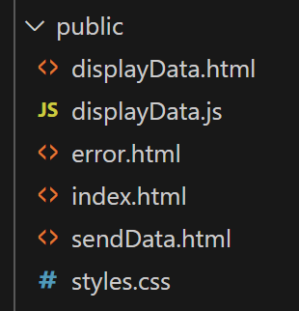
Serving Static Files
Create a new directory named “public” in your application’s directory.
In the “public” directory, add the following files (I will provide them to you):
displayData.html
displayData.js
error.html
index.html
sendData.html
styles.css
These files make up the Front-end of this demo full-stack application. It contains HTML, CSS and JavaScript.

Slide 30

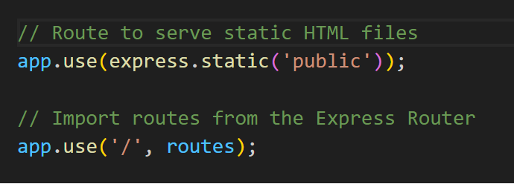
Serving Static Files
To make those files publicly-available, we must let Express know. Add the following line to app.js:
“express.static” is a built-in middleware that specifies where the static resources that can be publicly shared are located.
It is important that this line goes before the call to our router. Otherwise, the CSS and JS files in the ‘public’ folder will clash with our error handling.

Slide 31
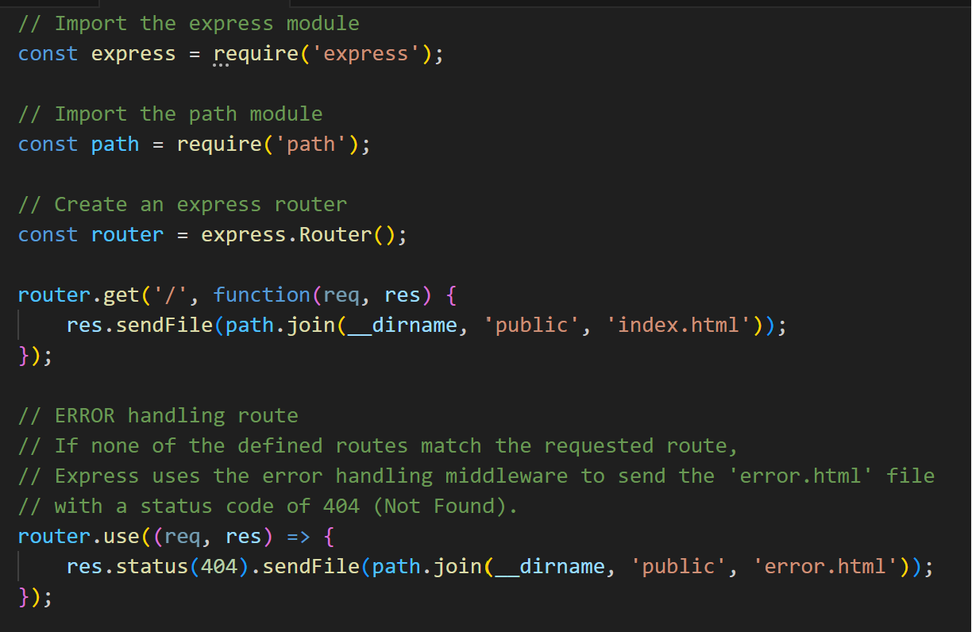
Serving Static Files
Now let’s update our router.js file with some new routes.
Import the ‘path’ core module so that we can get the path to the public files.
Update the GET request to ‘/’ to send the index.html file to the client.
Add a fallback route that catches any request not explicitly defined. This will send a 404 error and the error.html file to the client. This route should be LAST in the list.
Open a browser and verify it works.

Slide 32
Sending and Receiving Data via Front-End
Now our application has a homepage (index.html) and an error page (error.html). It also can use CSS for styling.
But we want to build an interactive application. One that can send and receive data dynamically using HTML forms and client-side JavaScript.
This can be done by adding the appropriate routes and using the Front-end files.

Slide 33
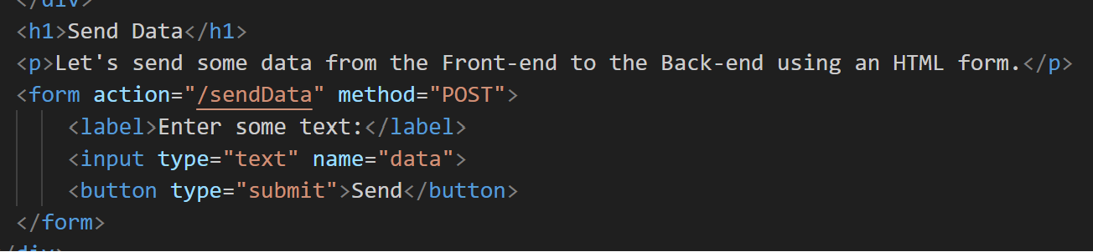
Receiving Data from the Front-End
To receive data from the Front-end, let’s look at the sendData.html file. This file has an HTML form that sends data from a text box through a POST method to the route “/sendData”.
Let’s create a route in our Back-end to receive that data.

Slide 34
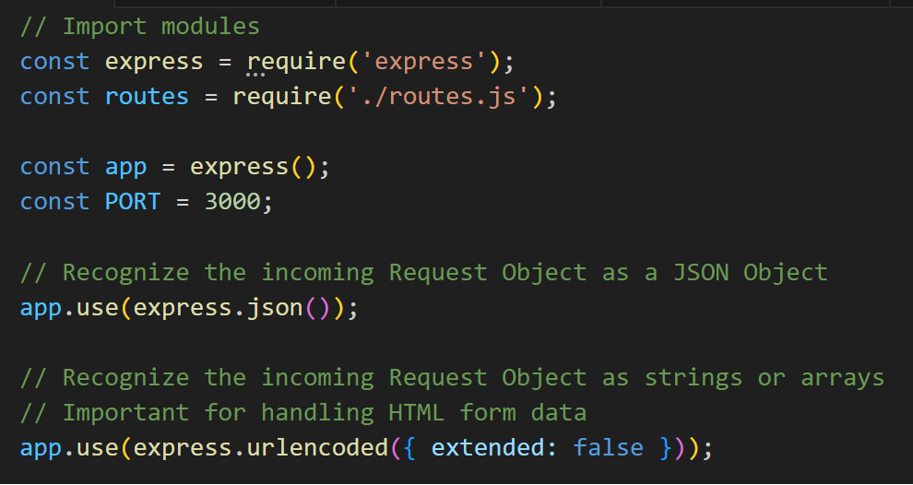

Receiving Data from the Front-End
To properly receive data from an HTML form, we need another express middleware.
Previously, we used the following middleware to recognize an incoming request object as JSON:
Use the following middleware to recognize an incoming request object as strings or arrays:
Notes:
https://expressjs.com/en/api.html#express.urlencoded

Slide 35
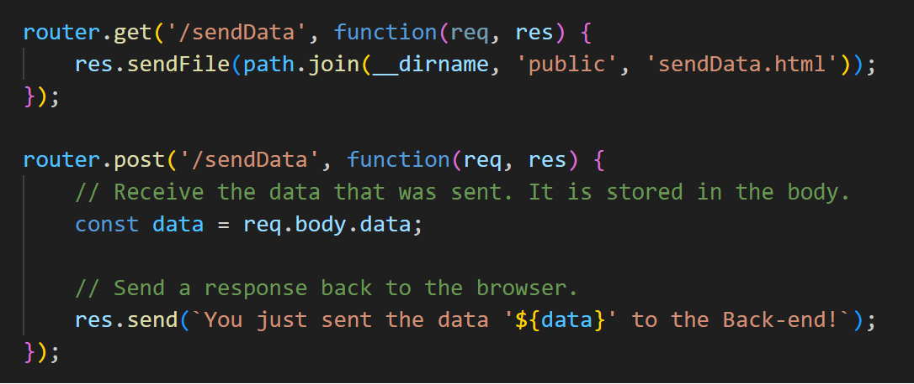
Receiving Data from the Front-End
Add the following routes to handle a GET request when a user wants to visit the HTML page, and a POST request that receives the data sent after the user clicks the Submit button.

Slide 36
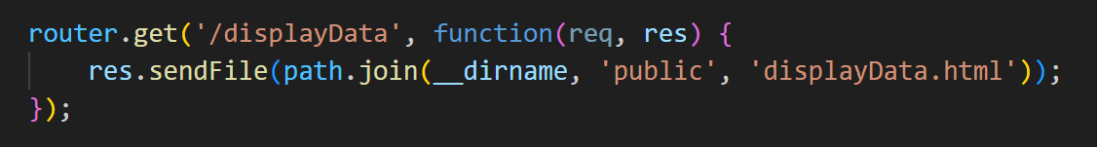
Sending Data to the Front-End
Now we want to send some data from the Back-end to the Front-end, and have that data be dynamically displayed on the page.
For this, we will use displayData.html and displayData.js.
First, we need a route to handle a GET request when a user wants to visit the HTML page.

Slide 37
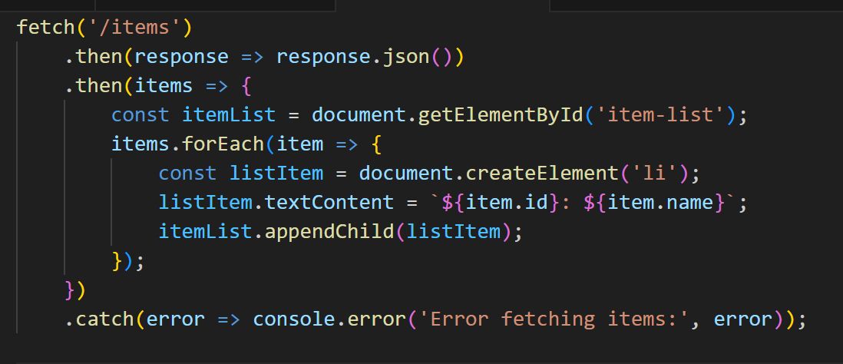
Sending Data to the Front-End
The displayData.html page includes a script displayData.js. That script makes a fetch request to the endpoint ‘/items’.
This is the same as making a GET request to the route ‘/items’.
It is expecting to get some JSON data, then will display that data dynamically on the page using promises.

Slide 38
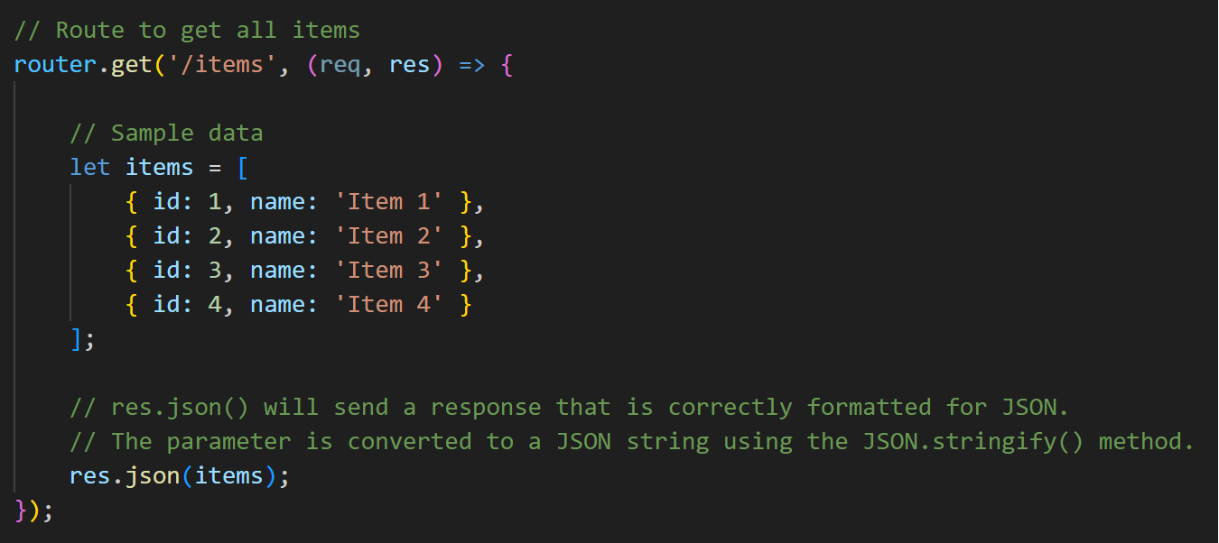
Sending Data to the Front-End
This means that we need to create a GET route at ‘/items’ and send some data to the client!
res.json() is a built-in express function that sends a JSON response. It will convert the parameter to a JSON string before sending.

Slide 39
Front-End ← → Back-End
We now have an application with a Front-end and a Back-end that can communicate!
Questions?

Slide 40
Assessments
Quiz 2:
Worth 10% of your grade.
Take it at-home, at your convenience.
Covers Module 3, Module 4, and Lesson 5.1.
40-minute time limit.
20 multiple-choice questions.
Due by August 15, 8:00am.

Slide 41
Group Project Check-in
What did your team accomplish since our last check-in?
What will your team accomplish by the next check-in?

Slide 42
For next class
Read Lesson 5.2 and do Learning Activities 5.2.1, 5.2.2, 5.2.3.
Assessments Reminder:
Quiz 2 due August 15, 8:00am.
Assignment 2 due August 20, 8:00am.
Group Project due August 22, 11:59pm.
All assessment dates have been posted in D2L.
See the “Assignments Policy” for late submission procedures.

Slide 43
References
https://www.tutorialspoint.com/expressjs/expressjs_routing.htm
https://expressjs.com/en/guide/routing.html
https://www.tutorialsteacher.com/nodejs/serving-static-files-in-nodejs
https://www.tutorialspoint.com/expressjs/expressjs_static_files.htm
https://expressjs.com/en/starter/static-files.html
https://www.geeksforgeeks.org/express-js-res-json-function/
https://www.scholarhat.com/tutorial/nodejs/expressjs-routes-routing
https://www.w3schools.com/whatis/whatis_fullstack.asp
https://www.tutorialspoint.com/expressjs/expressjs_environment.htm
https://www.geeksforgeeks.org/steps-to-create-an-express-js-application
https://www.geeksforgeeks.org/middleware-in-express-js/?ref=lbp

